Slide 1
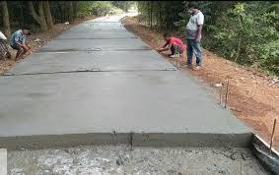
Construction and Quality Assurance/Control of Conventional Cement Concrete Pavements
As per MGNREGS/IRC-SP-62 (2014)
Compiled by
Y.Narasimha Rao, B.E. (Hons) [Civil]. M.Tech [Computer Science]
Project Advisor, APRRP (PMC),
Asian Infrastructure Investment Bank (AIIB)
&
Superintending Engineer (Retd)
PR Engineering Department, GoAP

Slide 2
Acknowledgements
Contribution of Er. K.Prabhakar Reddy, Project Advisor, APRRP (PMC) is gratefully acknowledged in the preparation of this presentation
Next

Slide 3
Scope
Construction of CC Road involves:
  Subgrade
  Sub-Base
  Base Course
  CC Pavement
Scope of the Presentation is limited to ‘CC Pavement’ Layer
Next

Slide 4
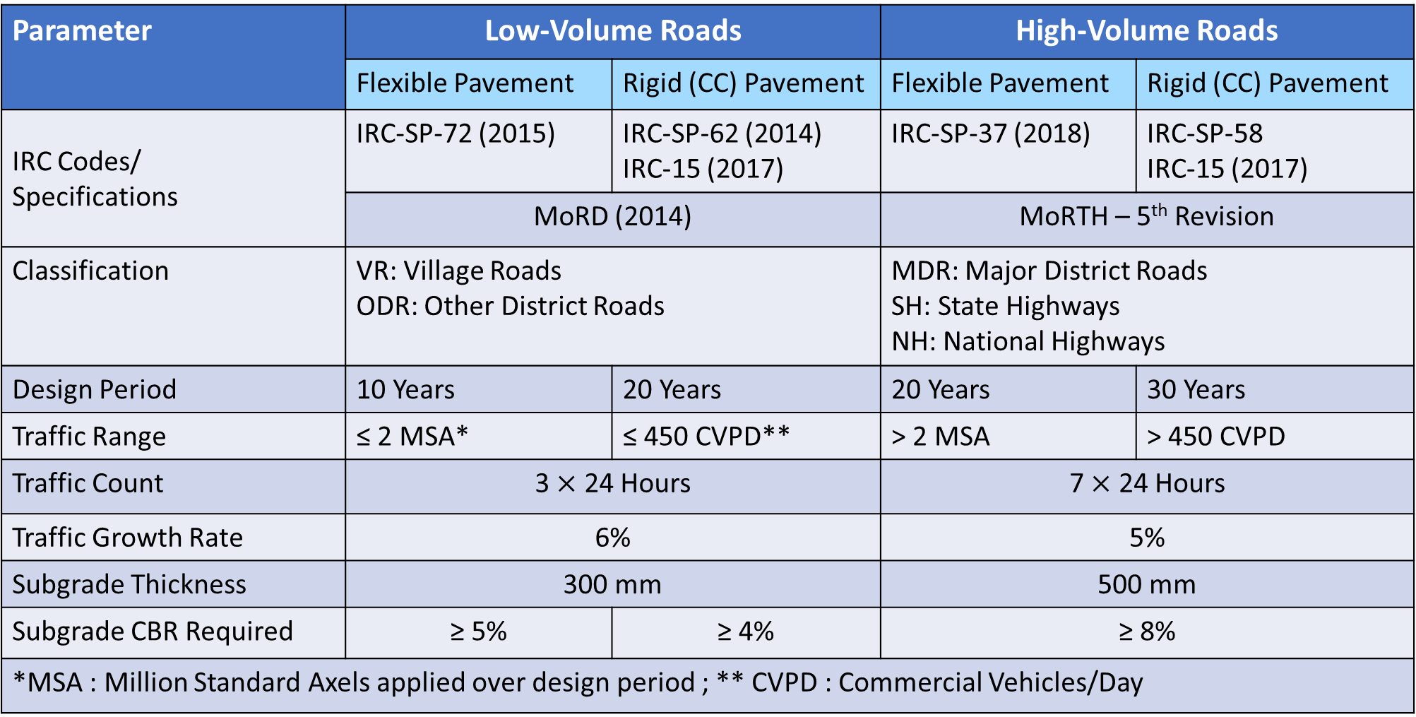
Low-Volume Roads vs High-Volume Roads
Parameter | Low-Volume Roads |  | High-Volume Roads
 | Flexible Pavement | Rigid (CC) Pavement | Flexible Pavement | Rigid (CC) Pavement
IRC Codes/ Specifications | IRC-SP-72 (2015) | IRC-SP-62 (2014) IRC-15 (2017) | IRC-SP-37 (2018) | IRC-SP-58 IRC-15 (2017)
 | MoRD (2014) |  | MoRTH – 5th Revision
Classification | VR: Village Roads ODR: Other District Roads |  | MDR: Major District Roads SH: State Highways NH: National Highways
Design Period | 10 Years | 20 Years | 20 Years | 30 Years
Traffic Range | ≤ 2 MSA* | ≤ 450 CVPD** | > 2 MSA | > 450 CVPD
Traffic Count | 3 $×$ 24 Hours |  | 7 $×$ 24 Hours
Traffic Growth Rate | 6% |  | 5%
Subgrade Thickness | 300 mm |  | 500 mm
Subgrade CBR Required | ≥ 5% | ≥ 4% | ≥ 8%
*MSA : Million Standard Axels applied over design period ; ** CVPD : Commercial Vehicles/Day
Next

Slide 5
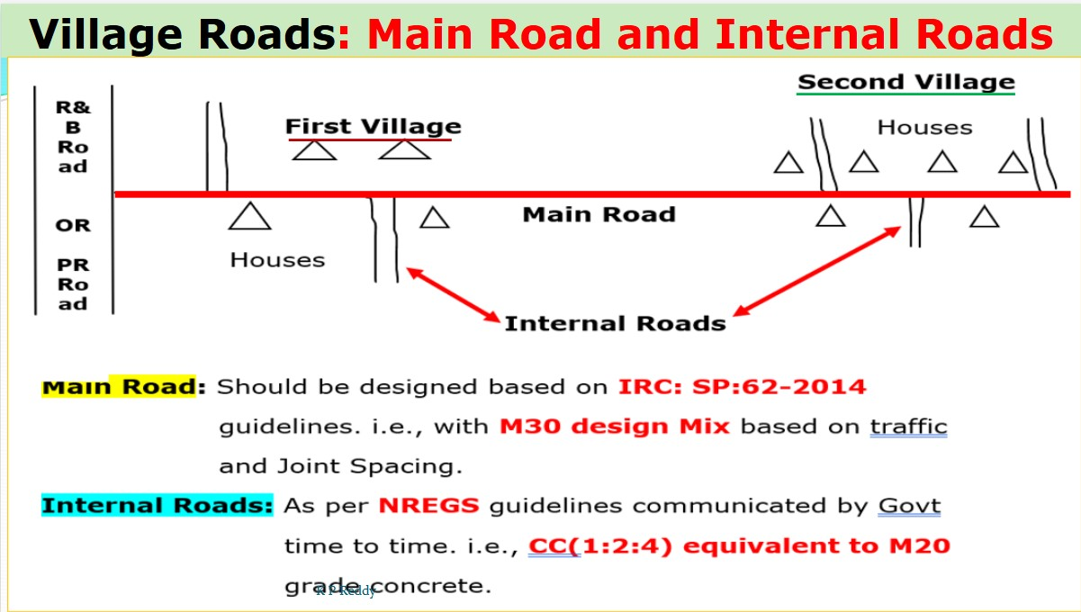
Village Roads – Main Roads & Internal Roads
Next

Slide 6
NREGS (AP) Guidelines for Internal /Village Roads
MGNREGS | IRC-SP-62 (2014)
Internal Village Roads with Traffic < 50 CVPD Pavement width ≤ 3.0 m | Main Village Roads (Irrespective of width of pavement & CVPD)
 | Internal Village Roads of pavement width > 3.0 m
Specifications
Parameter |  | MGNREGS | IRC-SP-62 (2014)
Grade of Concrete |  | VCC (1:2:4) equivalent to M20 | Minimum M30
Spacing of Contraction Joints |  | 2.50 m | 2.50 to 4.0 m as per choice of designer
Pavement Thickness |  | 125 mm | As per design subject to minimum of 150 mm
Sub-Base/Base | On existing BC soils | Stone Dust/Sand Filling – 150 mm thick + PCC (1:4:8) – 75 mm thick | As per Design based on Sub-Base/Base proposed – Granular/Cementitious
 | On existing Soils (other than BC soils) | Stone Dust/Sand Filling – 150 mm thick
 | On existing Gravel Road | Compacted Granular Material (Gravel/Stone Dust) – 100 mm thick [OR] WBM-Gr-II – 75 mm thick
 | On existing Metal (WBM/WMM) road | Stone Dust – 50 mm (for levelling)
Next

Slide 7
What are Rigid Pavements
Rigid Pavement is a type of pavement made up of multiple layers that do not allow the road to bend/deflect under traffic loads.
Characteristics of rigid pavements:
  Riding comfort is poor compared to that of flexible pavements
  Wear and Tear of vehicles is more compared to that of flexible pavements
  Low Maintenance Cost
  Suitable in poor drainage conditions
  Economical compared to flexible pavements – considering life cycle costs
Different Rigid/Cement Concrete Pavements:
    Conventional Screed-Compacted
    RCC (Roller Compacted)
    ICBP (Interlocking Concrete Block Pavement)
    Short-Panelled Concrete Pavement with panel size from 0.50x0.50 to 1.20x1.20 m
Next

Slide 8
Basics of Design
as per IRC-SP-62 (2014)
Next

Slide 9
What is Cement Concrete
Cement Concrete (or simply concrete) is a composite (heterogeneous) material, which hardens over time gaining strength, composed of :
  Cement
  Aggregates (Fine & Coarse)
  Water
  And Optionally
    Mineral Admixtures (Fly Ash, GGBFS* etc)
    Chemical Admixtures [Plasticizers, Retarders, etc.]
*Ground Granulated Blast Furnace Slag, which is a by product in steel industry
Next

Slide 10
Preliminaries
Conventional Concrete Pavements demand high degree of expertise in:
  Design
  Construction
  Maintenance
Pre-Requisites for Design of Conventional CC Pavements:
  Minimum Grade of Concrete is M30
  CC Pavements are designed for 90 days characteristic flexural strength
  Spacing of Contraction Joints can vary from 2.50 m to 4.0 m
  Minimum Subgrade CBR is 4%
  Width of Carriageway is 3.75. However, if width exceeds 4.50 m., longitudinal joints have to be provided with tie-bars
  Minimum thickness of CC pavement is 150 mm
Next

Slide 11
Design Factors
Following are the major Design Factors:
  Field Parameters
    Traffic
      CVPD
      Wheel Load - Single/Dual
      Tyre Pressure
    Subgrade CBR
  Designer Specifications
    Design Period
    Spacing of Contraction Joints
    Type of Sub-Base/Base Proposed – Granular/Cementitious
  Relevant properties of concrete – Modulus of Elasticity, Poisson Ratio, Coefficient of thermal expansion etc
Critical During Field Execution
Next

Slide 12
Design Outcomes
Following are Design Outcomes:
  Thickness of Pavement
  Thickness & Composition of Sub-Base/Base Course
Next

Slide 13
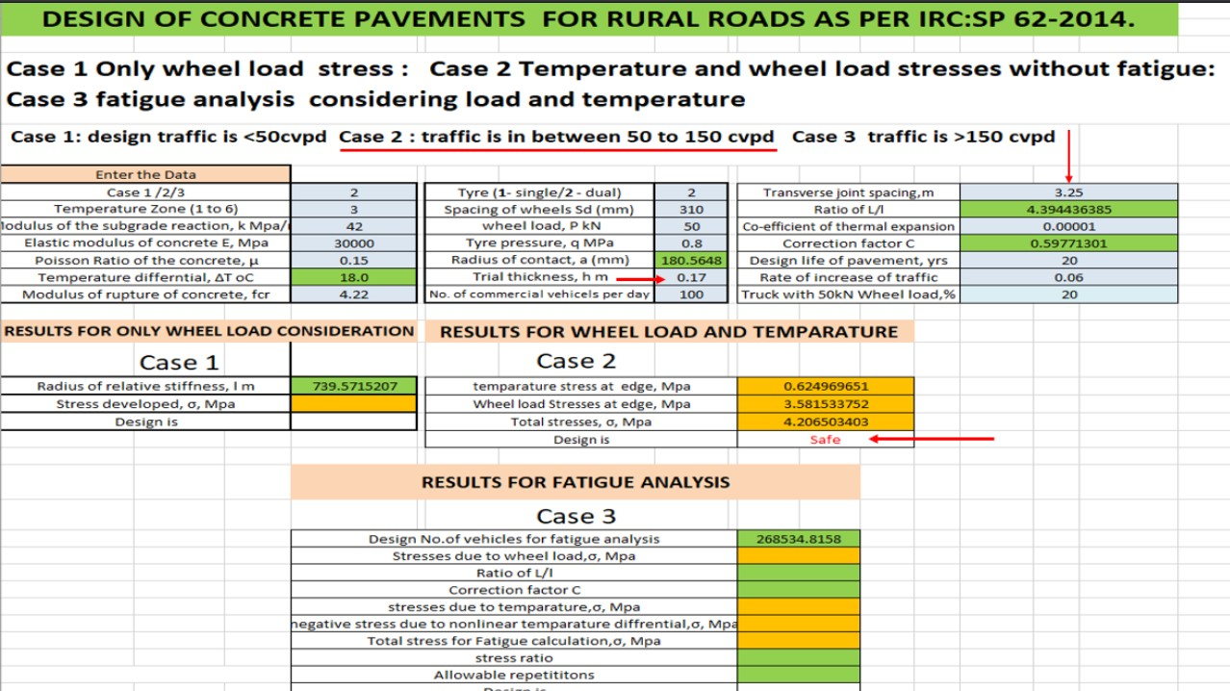
Importance of Joint Spacing
Next

Slide 14
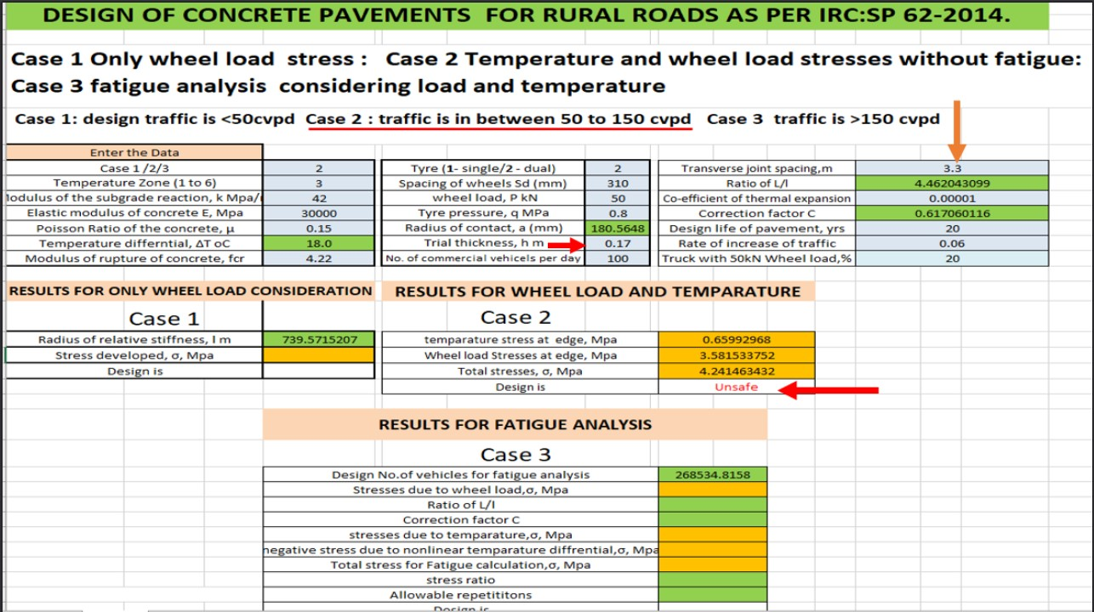
Importance of Joint Spacing
Just increasing joint spacing by 5 cm has resulted in the design becoming from safe to unsafe
Next

Slide 15
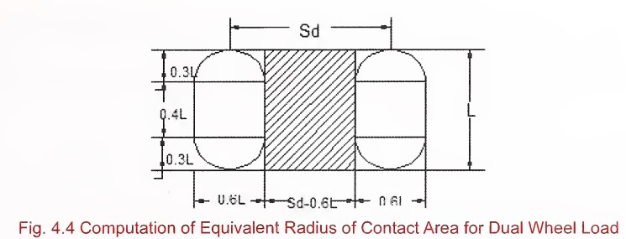
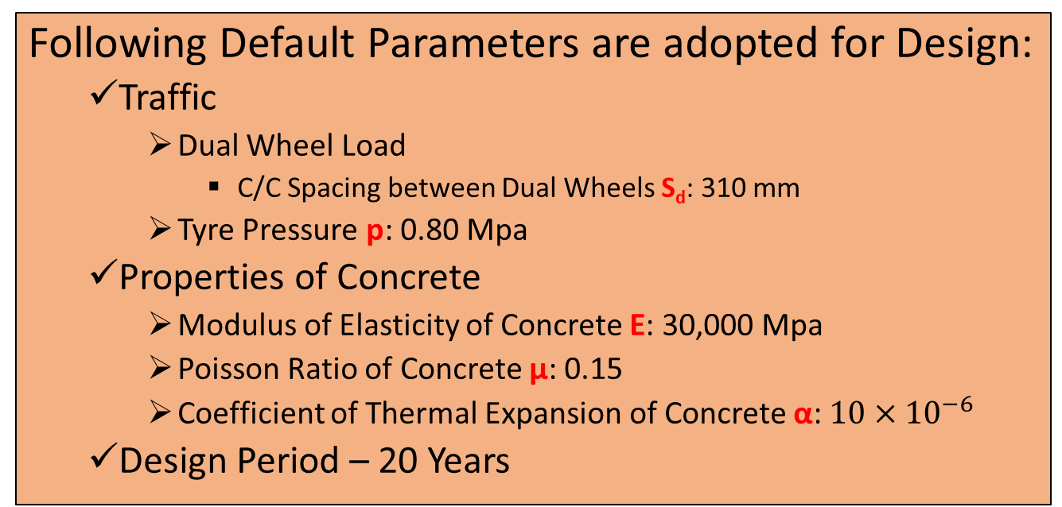
Default Design Parameters
Following Default Parameters are adopted for Design:
  Traffic
    Dual Wheel Load
      C/C Spacing between Dual Wheels S_{d}: 310 mm
    Tyre Pressure p: 0.80 Mpa
  Properties of Concrete
    Modulus of Elasticity of Concrete E: 30,000 Mpa
    Poisson Ratio of Concrete μ: 0.15
    Coefficient of Thermal Expansion of Concrete α: $10×{10}^{−6}$
  Design Period – 20 Years
Next

Slide 16
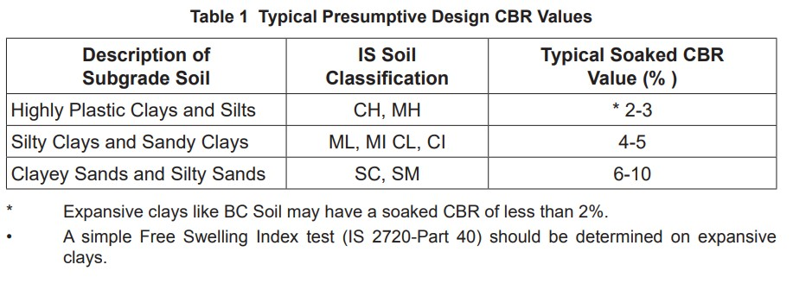
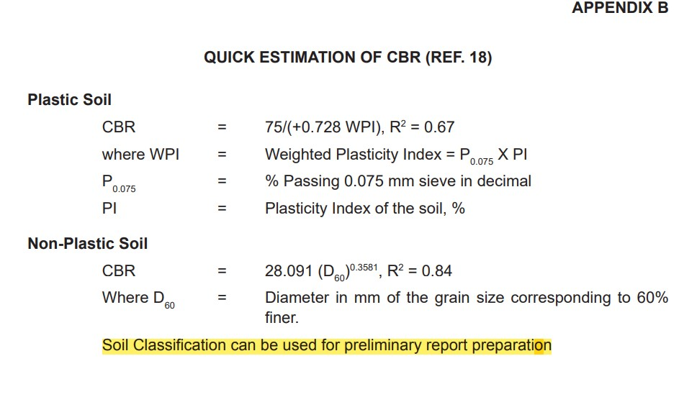
Empirical Methods of Determination of Subgrade CBR
Next

Slide 17
Mix Design
Mix Design is the process of determination of proportioning of various ingredients (that are proposed to be used) of concrete to obtain the requisite strength for the given grade of concrete as per IRC-44 and IS-10262 along with relevant clauses of IRC-15,IRC-112, MoRTH etc.
Mix Design for concrete shall be submitted at least 30 days prior to laying trail length to be done based on the materials (cement, coarse aggregate, fine aggregate, water, admixtures etc) proposed to be used in the construction and same has to be approved by concerned Executive Engineer
[Clause 602.3.1/602.3.5 of MoRTH & Clause 1803.24.1 of MoRD]
Next

Slide 18
Construction
Next

Slide 19
Construction
Materials
Plant, Tools, and Equipment/QC equipment
Construction Process
  Form work & Separation Membrane
  Mixing of Concrete
  Placement
  Compaction – Needle Vibrator & Plate Compactor
  Finishing – Screeding/Floating/Trowelling
  Texturing (for skid resistance)
  Curing – Initial/Intermediate/Final
  Construction of Joints – Initial Cut/Final Cut
  Sealing of Joints
Some of the construction operations do not rigidly follow the sequence shown above. For instance Curing, Texturing, and Joint Cutting overlap each other
Next

Slide 20
Materials
Materials for Concrete
  Cement
  Coarse Aggregate
  Fine Aggregate
  Water (should be potable quality)
  Admixtures (Optional but Recommended)
  Fibers (To reduce cracks – Not included in Data but recommended)
Materials for Joints
  Joint Sealing Compound
  Pre-Moulded Joint Filler Board (at Expansion Joints)
  Tie Bars (For Longitudinal Joints) / Dowel Bars (For Expansion Joints)
Specifications
Specifications
Specifications
Specifications
Specifications
Specifications
Specifications
Specifications
Next

Slide 21
Plant, Tools, and Equipment
RMC Plant/Ajax/Miller with suitable weigh batching mechanism.
Vibrating Screeds
Two Needle Vibrators (One being stand-by)
Plate Compactor
Texturing Brooms
Joint-Cutting Machine/ Mild Steel T-Sections bars with handles
Wheel Barrows/Iron Pans
Adequate No of spades/shovels/rakes
Joint Sealing tools/materials
For Expansion Joints (Adjacent to Bridges/Slab Culverts)
  Pump (to clean the holes/grooves of joints)
  Epoxy Gun (for filling holes)
  Dowel Bars & associated equipment
Next

Slide 22
Field Equipment for Quality Assurance/Quality Control
Core Cutting Machine
Slump Cone
Cube Moulds – 150 x 150 x 150 mm (for preparation of fresh concrete samples)
Sieves
Next

Slide 23
Construction Process
Next

Slide 24
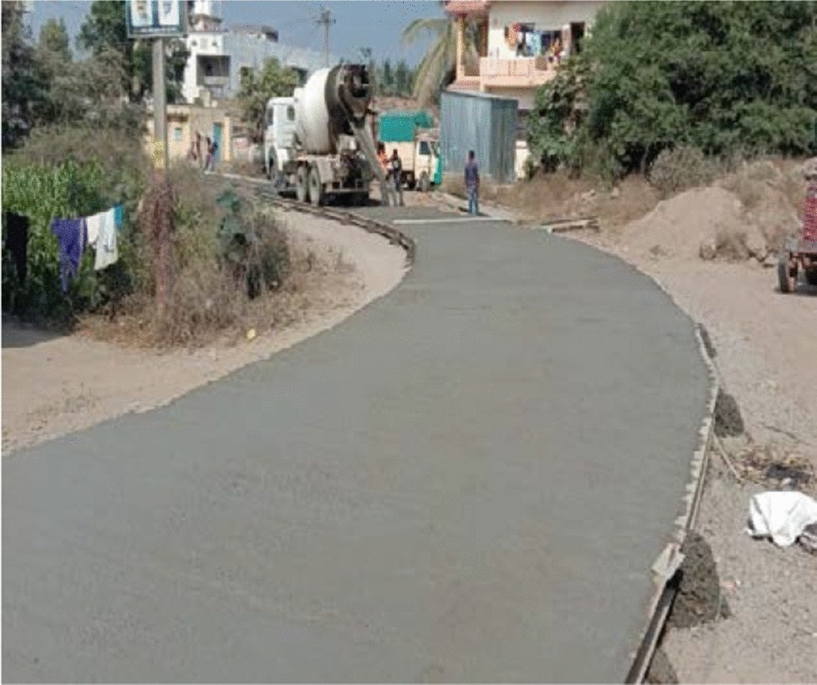
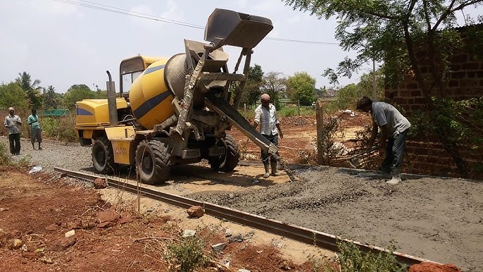
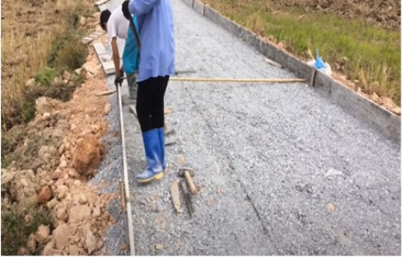
Form Work/Separation Membrane
  Side forms shall be mild steel sections
  Forms shall be fixed at appropriate spacing at normal sections and at super elevated sections
  Levels of forms shall be suitably fixed with water tube levels
  For curved portions of the road, flexible but strong card boards (high-density plywood) may be used as side forms, suitably secured
  All forms shall be oiled each time they are used
  Forms shall not be removed before 12 hours
  Separation Membrane (125 μ transparent/white polythene sheet) should be laid over prepared sub-base/base including overlapping on to side forms
Next

Slide 25
Mixing of Concrete
Mixing of Concrete can be done at RMC (ready Mix Concrete) Plant, or Ajax mixer, or concrete mixers for small jobs
The temperature of Green Concrete must not be more than 30º Celsius (Otherwise use of ice cubes/cold water and any chilling mechanism may be adopted for coarse aggregates)
Batching of materials shall be by weight (as per design mix)
Volumetric batching may be permitted for small jobs – preparing measuring boxes suitably considering proportioning as per design mix
Next

Slide 26
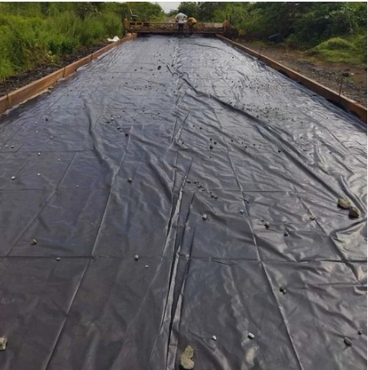
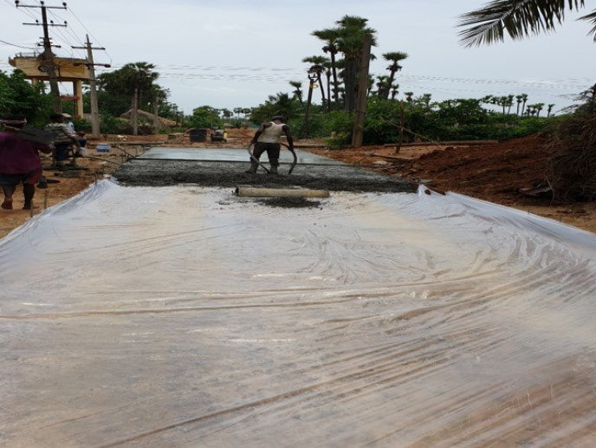
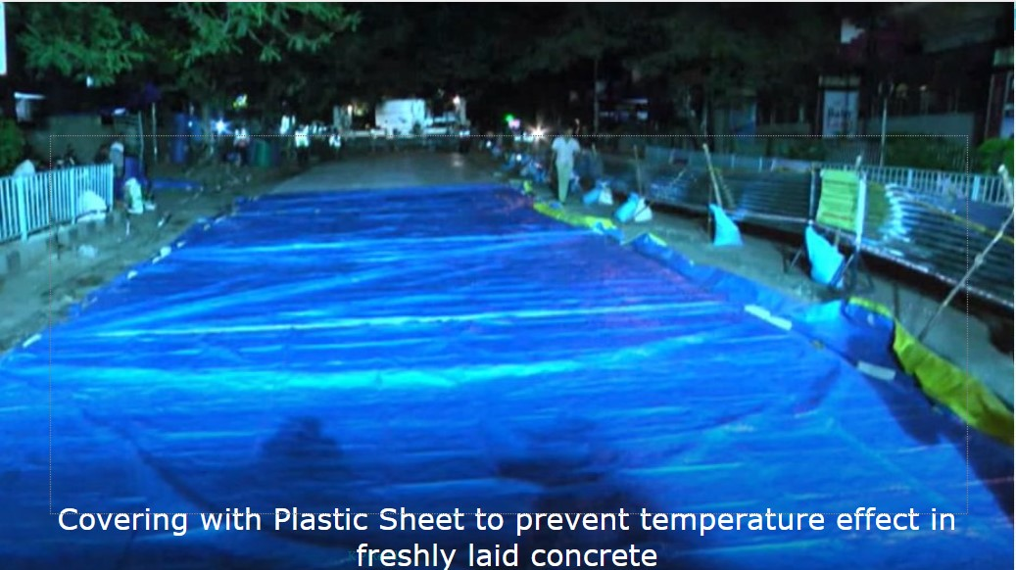

Placement of Concrete
The ambient temperature must not be more than 35º Celsius (if it is more, pavement surface to be covered with plastic sheets)
Concrete must be laid over 125-μ thick polythene separation membrane (white/transparent), which must overlap onto side form boards to prevent loss of cement slurry
Fall of concrete must not exceed 1.50 m (to prevent segregation of concrete ingredients)
Next

Slide 27
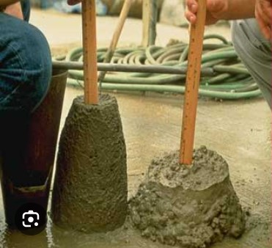
Placement of Concrete - Workability
The workability of the concrete shall be measured at the point of placement with slump cone test as per IS: 1199
Chemical admixtures (plasticizers/super-plasticizers) as per IS: 9103 may be used to improve workability of concrete for the same design W/C (Water-Cement) ratio
Maximum W/C (Water-Cement) ration is 0.50 (or as per mix design)
Slump Without Plasticizer
Slump Wit Plasticizer
Next

Slide 28
Compaction of Concrete
Effective Compaction makes the concrete dense and impervious
Over Compaction leads to segregation
Compaction by needle vibrators
  Always vibrate in vertical position
  Do not vibrate for more than 15 sec at one place
  Effective area of compaction depends on diameter of needle
    20 mm needle – 15 cm Dia
    40 mm needle – 30 cm Dia
  Hence keep shifting needle vibrator from one place as per above distance
Compaction should always commence before initial setting of cement
Next

Slide 29
Finishing
Finishing of concrete is done to obtain level and smooth surface
Operations involved in Finishing:
  Screeding
  Floating
  Trowelling
After finishing operations ‘Water Sheen’ appears.
To bloat water sheen, dry cement should not be spread on wet surface
Let the water sheen evaporate by itself
Only after water sheen evaporates, texturing operations should be taken up
Next

Slide 30
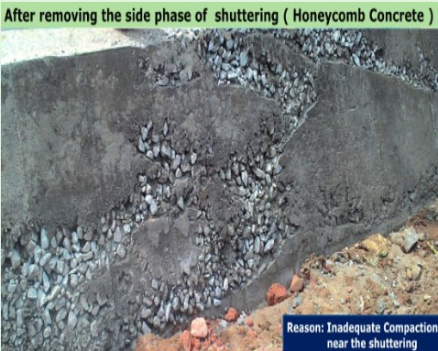
Removal of Forms
  Forms shall be removed only after the concrete is fully set – at any rate not before 12 hours
  After removal, the ends shall be cleaned and honey-combed areas pointed with Cement-Mortar (1:2)
  The sides of the slab covered with earth to the level of the slab
Next

Slide 31
Texturing
Texturing has to be done, just after the water sheen has disappeared, and just before concrete becomes non-plastic
Texturing is done to provide skid-resistance surface, so that vehicles do not skid during rainy season or in water-logged conditions
Texturing is to be done by standard texturing brushs. However, texturing can be done with local broom – but minimum width of broom should be 450 mm
Next

Slide 32
Curing
Curing is required:
  To maintain moisture inside the freshly cast concrete
  To continue the hydration process
  To achieve the desired properties of the hardened concrete
Next

Slide 33
Curing - Stages
Stages of Curing:
  Initial Curing
    If initial curing is not done, it will lead to development of plastic shrinkage cracks
    To be done after about 3 hours of casting of concrete
    Sprinkling water @ 200 ml/sqm
  Intermediate Curing
    Application of Water proofing compounds to prevent loss of moisture during texturing & initial cut of jointing
  Final Curing (Ponding/Saturated burlaps etc)
    Final Curing has to commence after completion of Texturing & Initial Cut of Jointing
    It should commence after 6 hours or at the minimum before 24 hours
    To be done for a minimum of 14 days
Next

Slide 34
Construction of Joints
Types of Joints:
  Contraction Joints
    To be cut to 1/3rd to 1/4th of slab thickness and to a width of 3 mm
    Final Cut is done after completion of final curing
    Dimensions of final cut are 10-12 mm deep and 8 - 10 mm wide to accommodate sealing of joints
    The spacing should be provided strictly as per design
  Construction Joints
    Shall be provided whenever concreting is completed for Day’s work OR work is suspended for more than 30/90 minutes
    They should always match spacing of Contraction Joints
    The Joints must be vertical
  Expansion Joints
    Necessary for concrete slabs abutting approach slabs of bridges/culverts
    No need to provide in road portion
  Longitudinal Joints – shall be provided when the width of concrete slab exceeds 4.50 m
Next

Slide 35
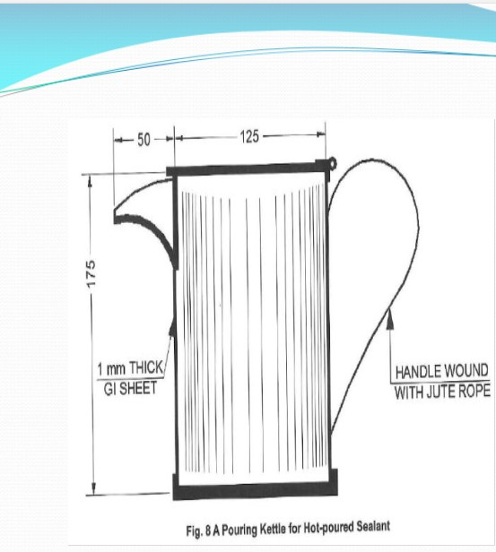
Sealing of Joints
Sealing of joints is provided to prevent ingress of water from pavement surface to the subgrade through the joints.
  Only hot poured sealing compound type having flexibility, resistance to age hardening, and durability conforming to IS: 1834 (and NOT bitumen – which hardens and brittles and can not prevent ingress of water into subgrade)
  Before pouring, the joints must be cleaned with air compressor
  A debonding strip/Rope to be inserted into joint to prevent ingress of sealant from concrete pavement into lower pavement layers
  In order to prevent spillage of sealant on the concrete surface, card-board or tape is stuck on both edges of the joint before pouring
  A standard kettle is used for pouring sealant manually
Next

Slide 36
Quality Assurance & Quality Control
During Construction (Daily)
  Slump Test
    Slump is related to workability of concrete
    Slump is a design parameter in the Mix Design Process, and based on grade and type of work
    For Hand Placed Concrete pavements the required slump is 25 to 75 mm
    Admixtures – Plasticizers/Super Plasticizers can be used to improve workability without affecting water-cement ratio
  Cast Cube Moulds – 150 x 150 x 150 mm – 6 No (min) /day
Post-Construction
  Testing of cube moulds (7 days/28 days) – Check acceptance criteria
  Core-Cutting Tests – Check Acceptance Criteria
    PIU Engineers
    External Quality Monitors
Next

Slide 37
Sequence of Construction Operations [Timelines]
Formwork/Separation Membrane
Mixing of Concrete
Placement of Concrete
< 30 minutes
Compaction of Concrete
Finishing Operations
Water Sheen Appears
Water Sheen Disappears
Within 3 to 4 Hours
Texturing
Initial Curing
Intermediate Curing
Within 24 Hours
Joint Cutting – Initial Cut
Final Curing
Minimum 14 days
Joint Cutting – Final Cut
After Final Curing
Joint Filling with Sealant
Next

Slide 38
References (CivilApps: https://www.civilapps.in)
  Codes
    Design of Cement Concrete Pavements : IRC-SP-62 (2014), IRC-58
  NREGS GOs/Circulars (CivilApps → Documents → Gos/Circulars)
    GO MS No 91, Dt. 16/9/2015 of PR & RD (RD-II) Department, GoAP
    Circular Memo No 1073/Progs-I/2016-1, Dt. 25/01/2016 of PR & RD (Progs-I) Department, GoAP
  Presentations (CivilApps → Media → Presentations)
    Construction of CC Roads as per MoRD – Er. K.Prabhakar Reddy, Project Advisor, APRRP (PMC)
    Design of Rigid Pavements for Low-Volume Roads – Er. Y.Narasimha Rao , Project Advisor, APRRP (PMC)
  Applications (CivilApps → Applications → Excel Applications)
    Design of Cement Concrete Pavement for Low-Volume Roads – Er. Y.Narasimha Rao, Project Advisor, APRRP (PMC)
Next

Slide 39


Next
Creation of Adam by Michelangelo (15th Century Renaissance Painting)

Slide 40
Thank You
Any Queries before Demo of Application

Slide 41
Cement
Following types of cement can be used:
  OPC (Ordinary Portland Cement)
    Grade 33 [IS: 269]
    Grade 43 [IS: 8112]
    Grade 53 [IS: 12269]
  PPC (Portland Pozzolana Cement) – Grade 33 [IS: 1489]
  PBFS (Portland Blast Furnace Slag) Cement [IS: 455]
Note:
  If PPC is used, fly ash should not be blended
  If OPC is used, it is preferable to use 43 grade cement
  If OPC – 53 grade cement is used, it should be blended with 5% of Fly Ash
Next

Slide 42
Relative comparison of OPC and PPC
Parameter | OPC | PPC
Setting Time | Fast | Slow
Strength | High Initial Strength | Low Initial Strength, but gains strength over time
Rate of Shrinkage | High | Low
Prone to Cracking | High | Low
Note: PPC is preferable in mass concrete works and also in coastal environments
Next

Slide 43
Grade of Cement
Grade denotes 28-days average compressive strength of cement, tested on 70.6/ 50 mm cubes (at least 3 cubes) of 1:3 cement mortar (1 part of cement and 3 parts of standard sand, as per IS: 650)
Next

Slide 44
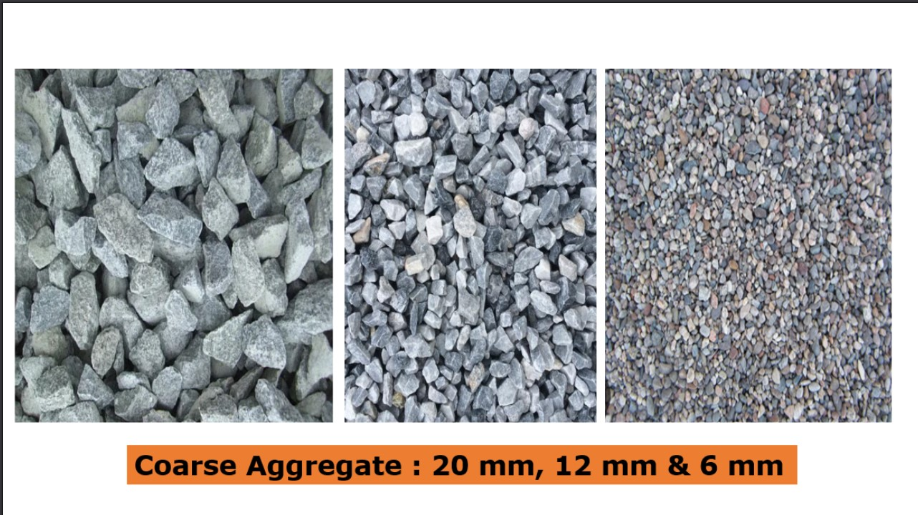
Coarse Aggregate
Next

Slide 45
Specification of Coarse Aggregate
Parameter | Permissible Values
Material | Crushed stone/gravel
Gradation (Combined Aggregates) | As per Table 1500.1 of MoRD-2014
Maximum size of Aggregate | 25 mm
AIV (Aggregate Impact Value) | ≤ 30%
Flakiness Index | ≤ 35%
Water Absorption | ≤ 5% (if it is more than 3%, aggregate has to be tested for soundness as per IS: 2386 (Part-V)
Next

Slide 46
Grading requirement of Coarse Aggregate for nominal mix (1:2:4)
IS Sieve Size | % Passing
 | 20 mm | 12 mm
40 mm | 100 | -
20 mm | 95 - 100 | 100
12.5 mm | - | 90 - 100
10 mm | 25 - 55 | 40 - 85
4.75 mm | 0 - 10 | 0 - 10
Next

Slide 47
Grading requirement of Combined Aggregate
IS Sieve Size | % Passing
 | Table 1500.1 of MoRD (2014) | Table 6.2 of IRC-SP-62 (2014)
31.5 mm | 100 | -
26.5 mm | 85 - 95 | 100
19 mm | 68 - 88 | 80 - 100
9.5 mm | 45 - 65 | 55 - 75
4.75 mm | 30 - 55 | 35 - 60
600 μ | 8 - 30 | 10 - 35
150 μ | 5 - 15 | -
75 μ | 0 - 5 | 0 - 8
Next

Slide 48
Specification of Fine Aggregates
Parameter | Permissible Values
 | Natural Sand | Crushed Stone Sand | Blend of Natural & Crushed Stone
Clay Content | ≤ 1 %
Coal & Lignite | ≤ 1 %
Material finer than 75 μ | ≤ 3% | ≤ 12 % (15% in exceptional cases) | ≤ 8%
Material finer than 150 μ | - | ≤ 20% | -
Next

Slide 49
Zone of Fine Aggregates (% Passing)
IS Sieve | Sand for Concrete(Table 9 of IS:383-2016) |  |  |  | Sand for Plaster (IS: 1542 – 1992) | Sand for Mortar (IS: 2116-1980)
 | Zone -1 | Zone-2 | Zone-3 | Zone-4
10 mm | 100 | 100 | 100 | 100 | 100 | -
4.75 mm | 90 - 100 | 90 - 100 | 95 - 100 | 95 - 100 | 95 - 100 | 100
2.36 mm | 60 - 95 | 75 - 100 | 85 - 100 | 95 - 100 | 95 - 100 | 90 - 100
1.18 mm | 30 - 70 | 55 - 90 | 75 - 100 | 90 - 100 | 90 - 100 | 70 - 100
600 μ | 15 - 34 | 35 - 59 | 60 - 79 | 80 - 100 | 80 - 100 | 40 - 100
300 μ | 5 - 20 | 8 - 30 | 12 - 40 | 15 - 50 | 20 - 65 | 5 - 70
150 μ | 0 - 10 | 0 - 10 | 0 - 10 | 0 - 15 | 0 - 15 | 0 - 15
Fineness Modulus | 3.91 – 2.71 | 3.37 – 2.11 | 2.78 – 1.71 | 2.25 – 1.35 | 2.20 – 1.20
Note:
While all zones of sand can be used for plain cement concrete, for RCC concrete zone-4 sand can not be used
Zone of FA for Concrete: The limits of % passing of one zone overlaps with adjacent zones for all sieve sizes, except 600 μ. Hence 600 μ sieve is used to decide zone of fine aggregate for concrete
Fineness Modulus must be between 2.0 and 3.50
Next

Slide 50
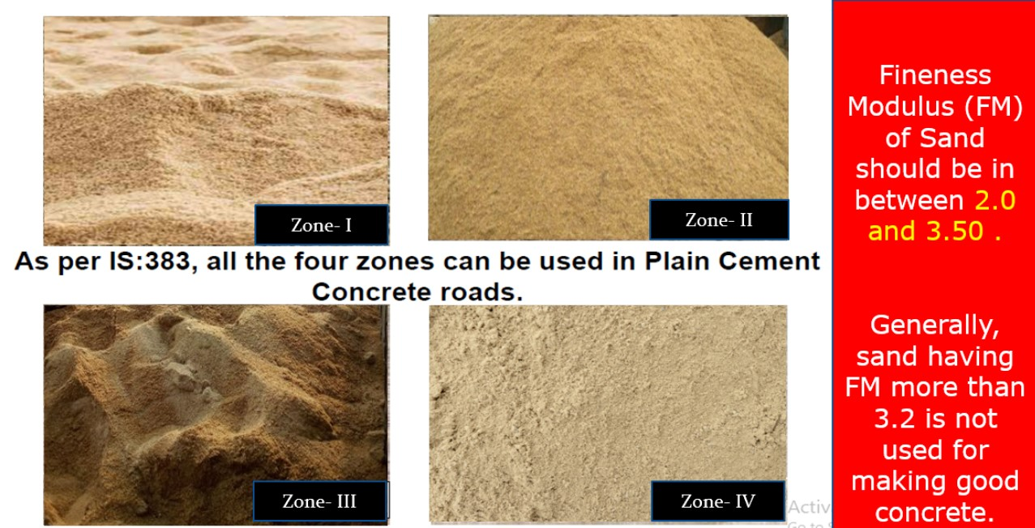
Zone of Sand
Next

Slide 51
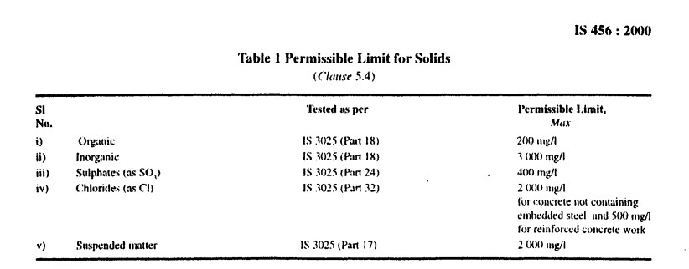
Specification for Water
Next

Slide 52
Specification for Admixtures
Admixtures (Plasticizers/ Super Plasticizers) conforming to IS: 6925 and IS: 9103 can be used up to 2% of cement weight.
Admixtures improve workability / extension of setting time of concrete
Next

Slide 53
Specification for Sealing Compounds
The Sealing Compound should be hot poured sealing compound type having flexibility, resistance to age hardening, and durability conforming to IS: 1834
Note: Conventional BT should not be used as sealing compound as is being done usually in practice
Next

Slide 54
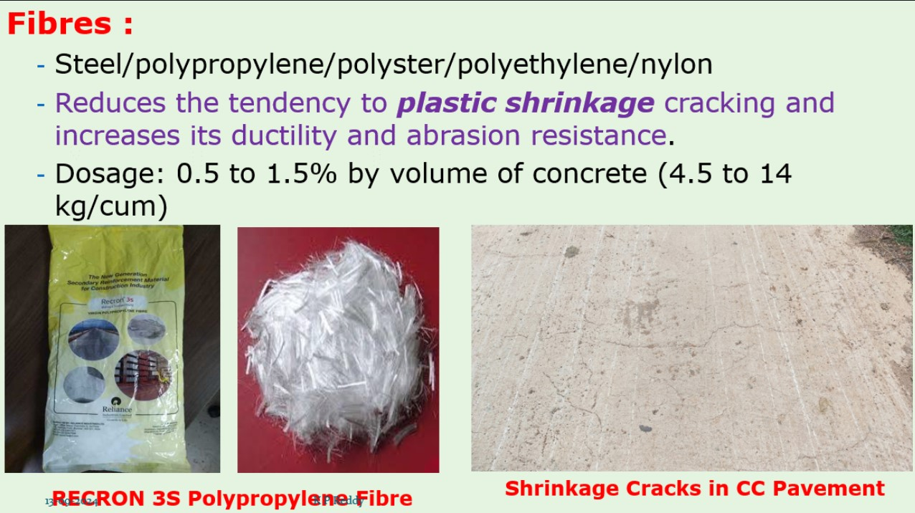
Fibers

Slide 55
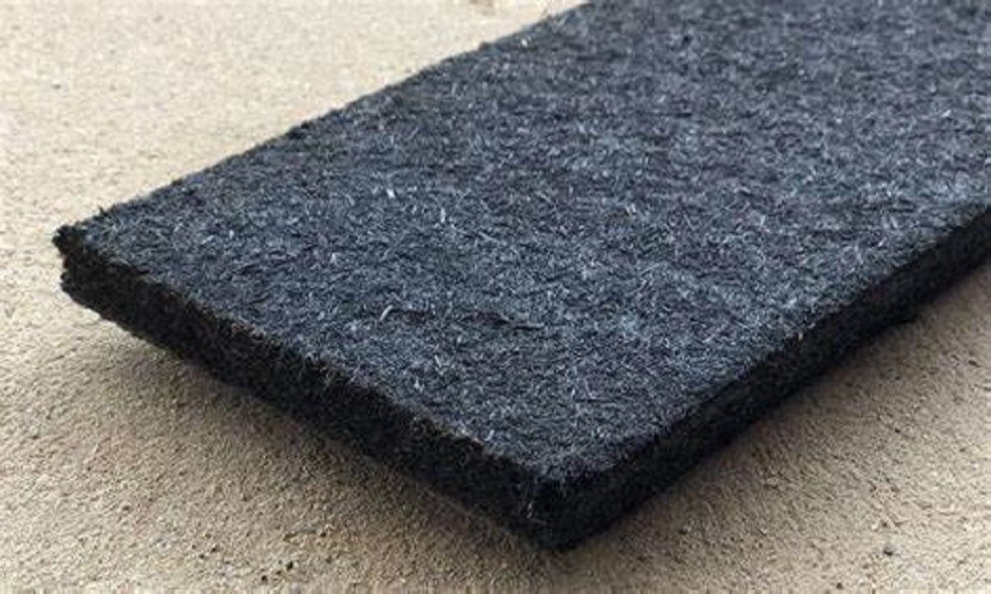
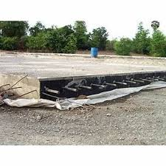
Joint Filler Board for Expansion Joints
Bitumen-Impregnated filler board/pre-moulded synthetic joint filler board shall be 20 mm thick as per IS:1838

Slide 56
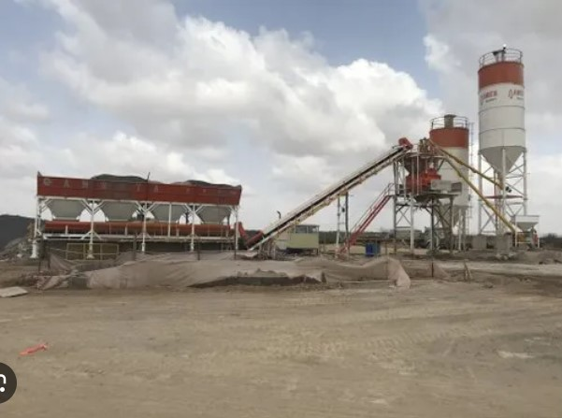
Ready Mix Concrete
Ready mix concrete manufactured with computer-controlled mixing of concrete ingredients and transported through truck-mounted mixers
Superior quality concrete is produced with stringent quality assurance/control
Admixtures are used to retard setting time for the RMC for transportation to the work site
Concrete shall be discharged from truck-mixers within 2 hours. However longer periods may be permitted if retarding admixtures are used
Concrete shall be discharged within 30 minutes on arrival at site
Next

Slide 57
Ajax Concrete Mixer
Next

Slide 58
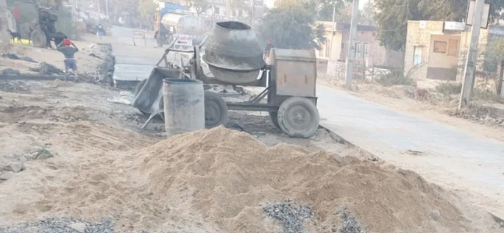
Concrete Mixing by Millers (Small Job Works)
Next

Slide 59


Slide 60
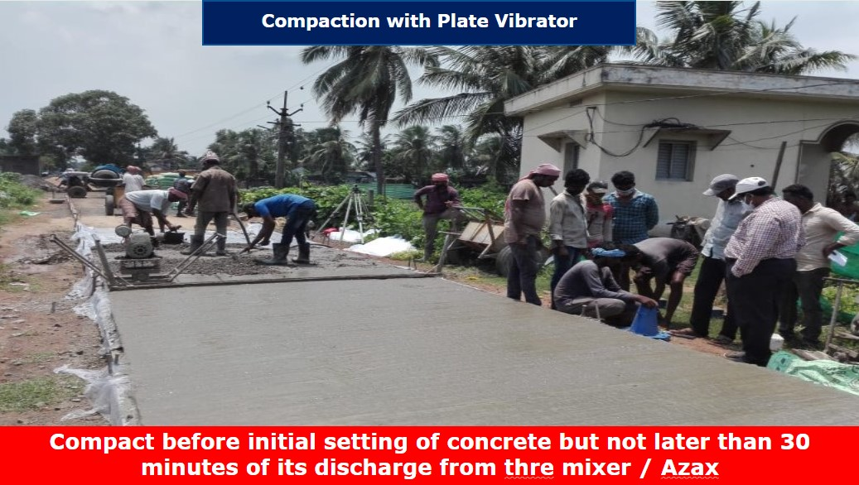

Slide 61
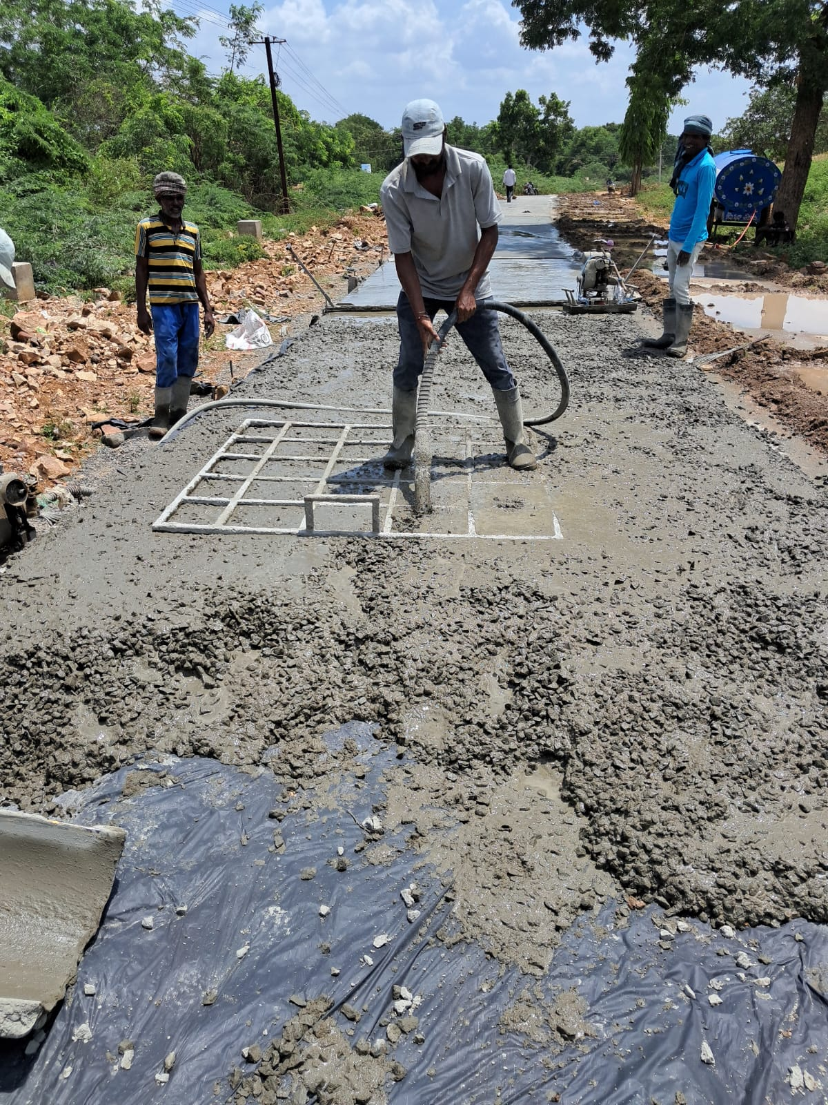
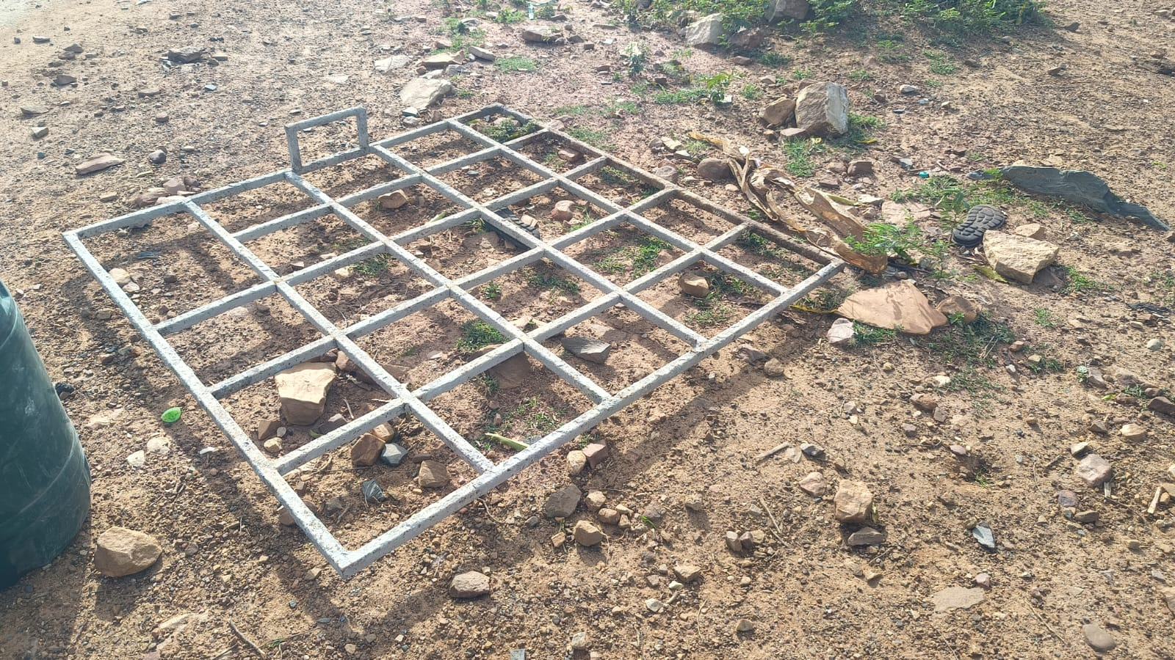
Compaction with Needle Vibrator evenly with the help of a Iron-Bar Grid

Slide 62
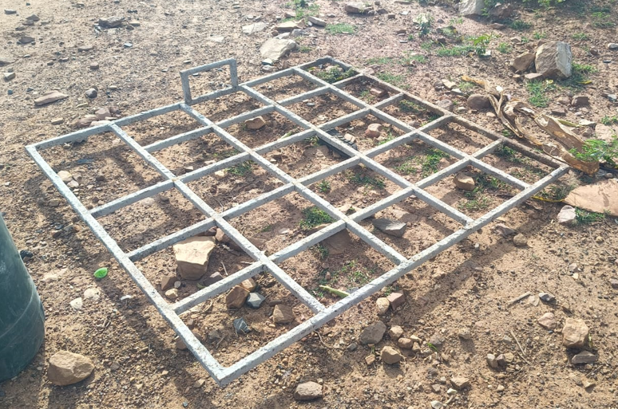
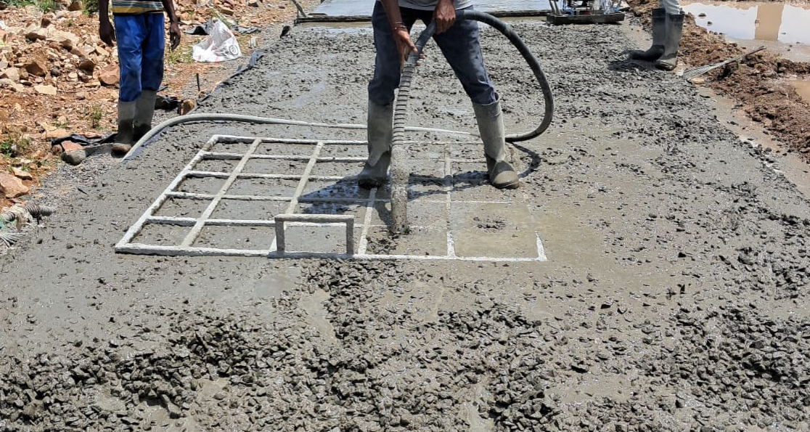
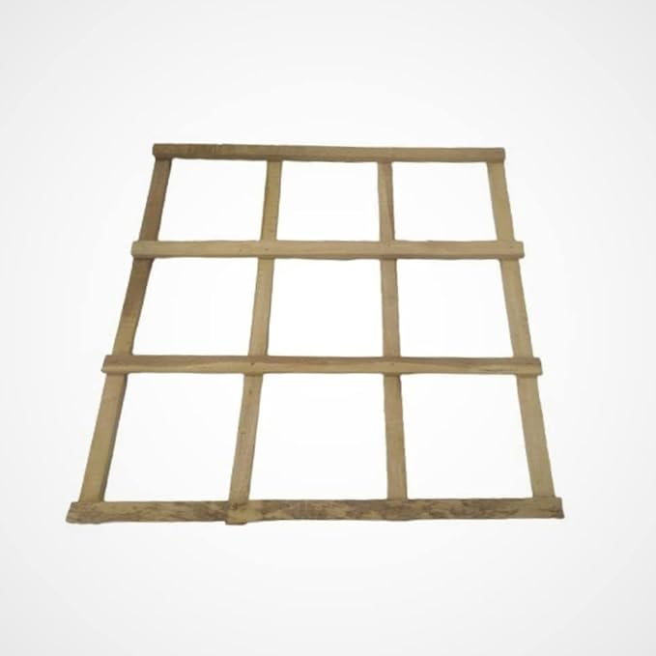
How to attain proper compaction with Needle Vibrator?
Grid with Bamboo
Grid for Needle Vibrator Placing - for uniform compaction

Slide 63
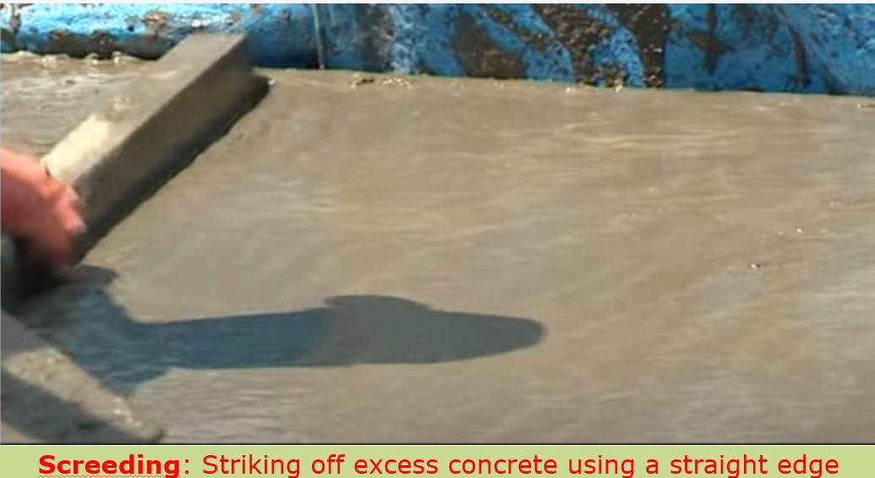
Vibrating Screeds
They must be appropriate length so that same can be supported on side forms for tamping and compaction
One screed vibrator shall have straight bottom for use on super-elevated sections
Another screed vibrator specified parabolic camber
Next

Slide 64

Screeding & Compacting – Combined Action
Next

Slide 65
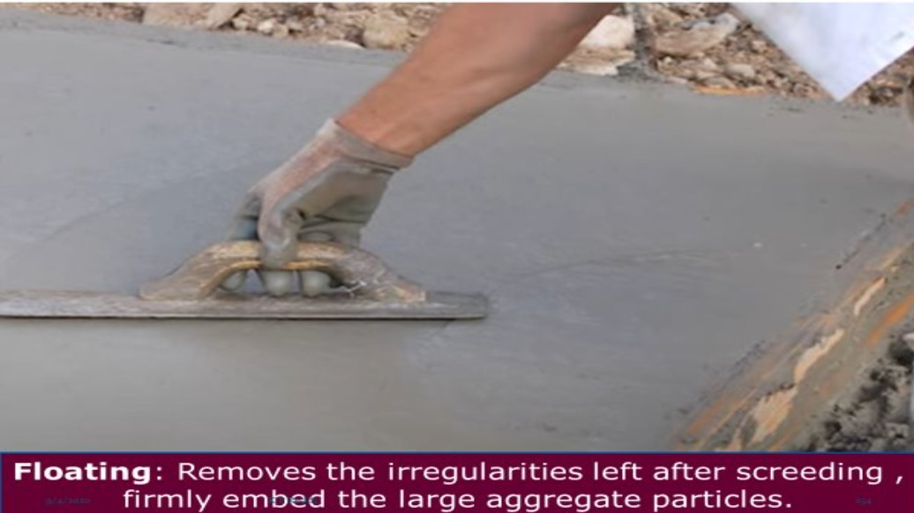
Floating
Next

Slide 66
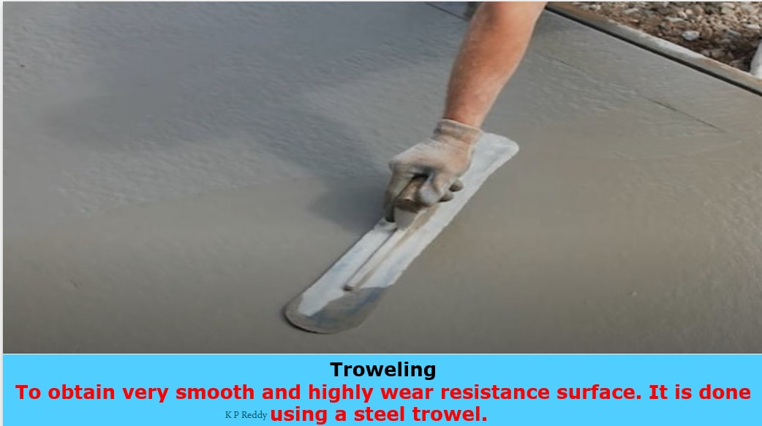
Trowelling
Next

Slide 67
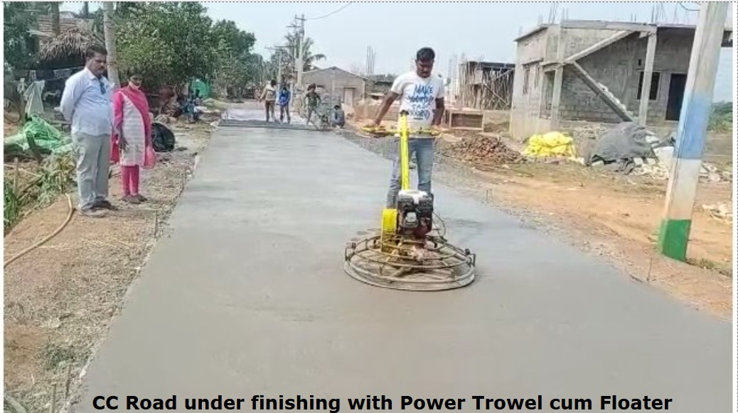
Power Trowelling
Next

Slide 68
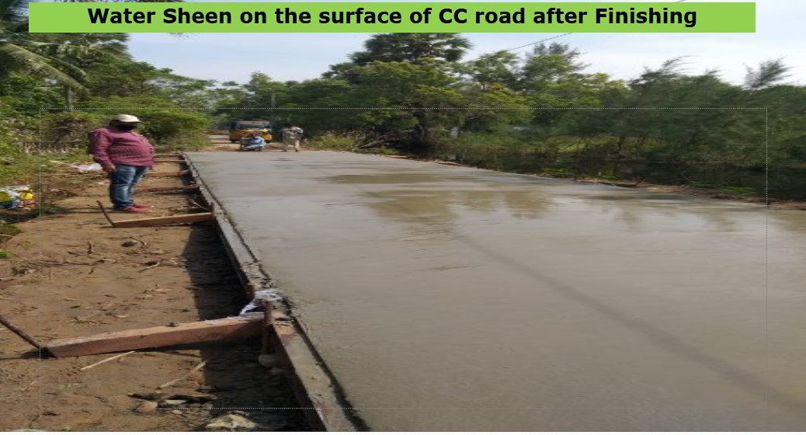
Water Sheen
Next

Slide 69
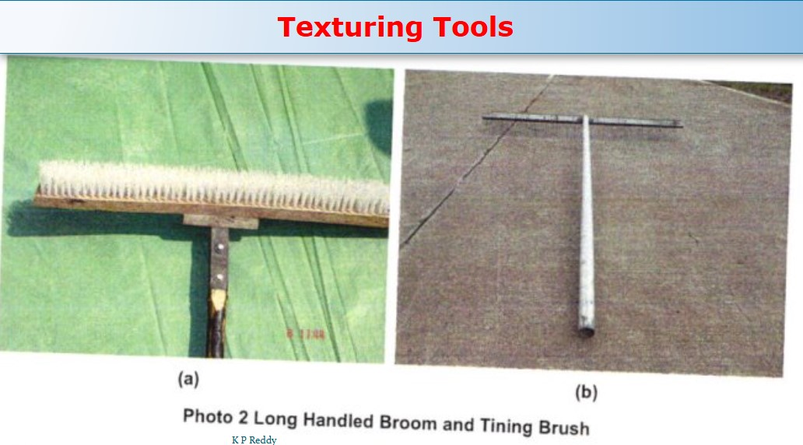
Texturing Tools
Next

Slide 70
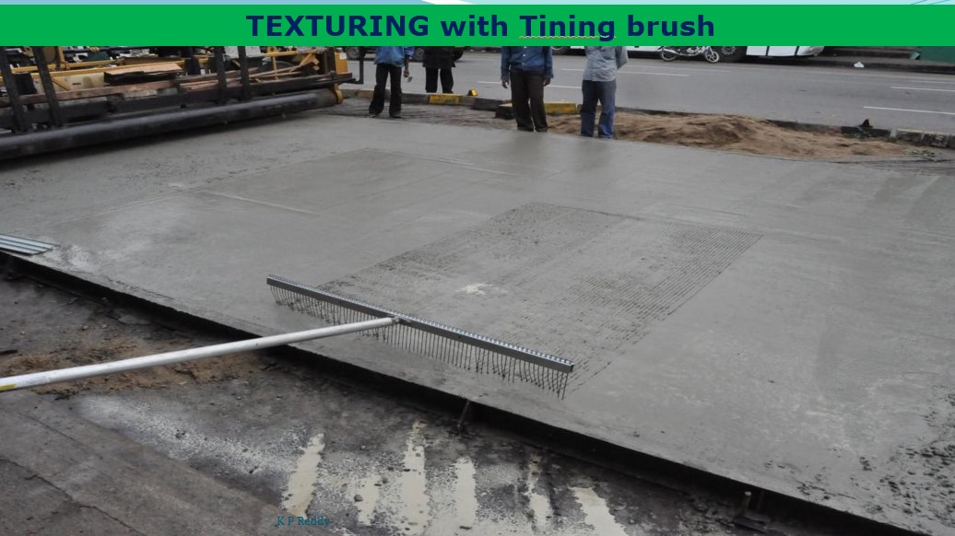
Texturing – Tining Brush
Next

Slide 71
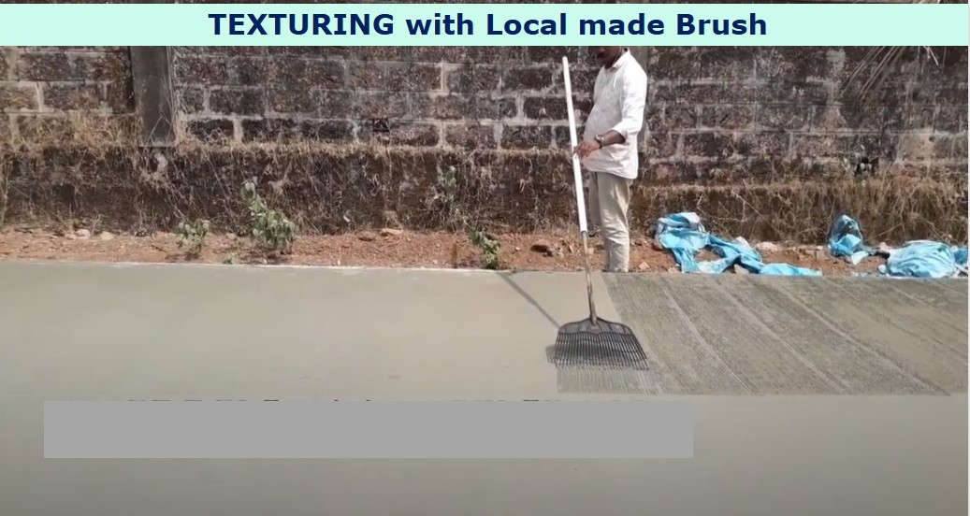
Texturing – Local Brush
Next

Slide 72
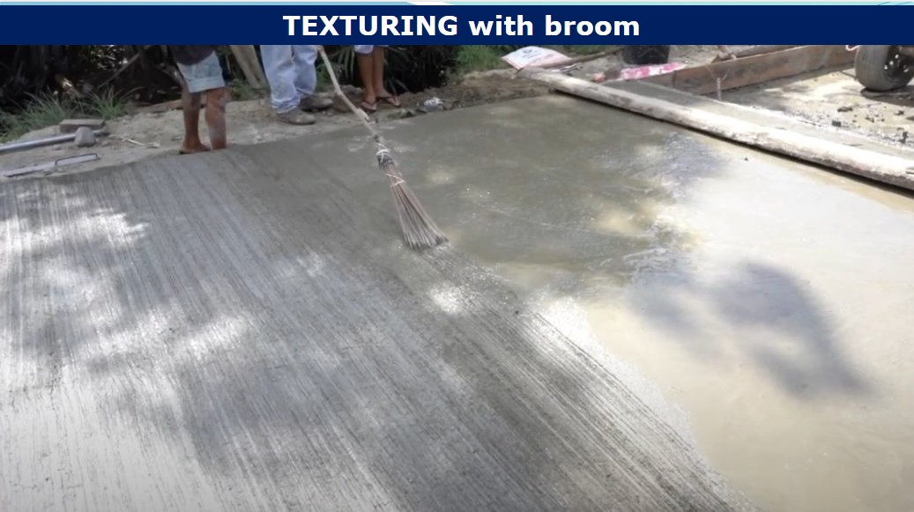
Texturing – Broom
Not Recommended as the width of the broom is less than 450 mm
Next

Slide 73
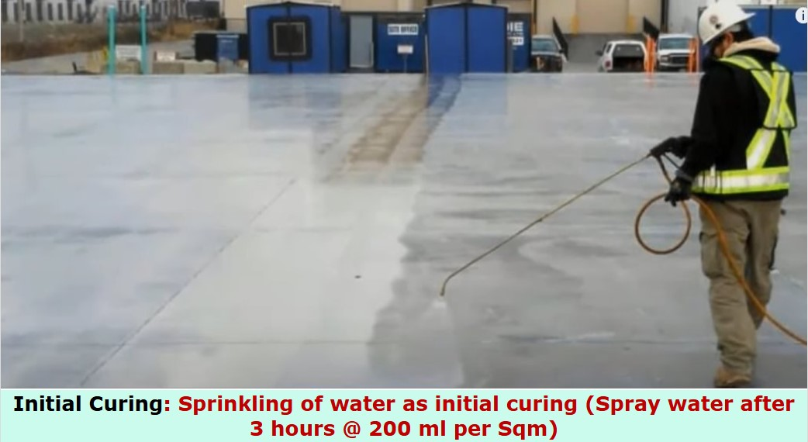
Initial Curing
Why is it required – During Initial Setting Time, some times bleed water is evaporating from the surface faster than it is rising out from the concrete. When all the water gets evaporated from the surface, initial curing has to be done to minimize moisture loss
Next

Slide 74
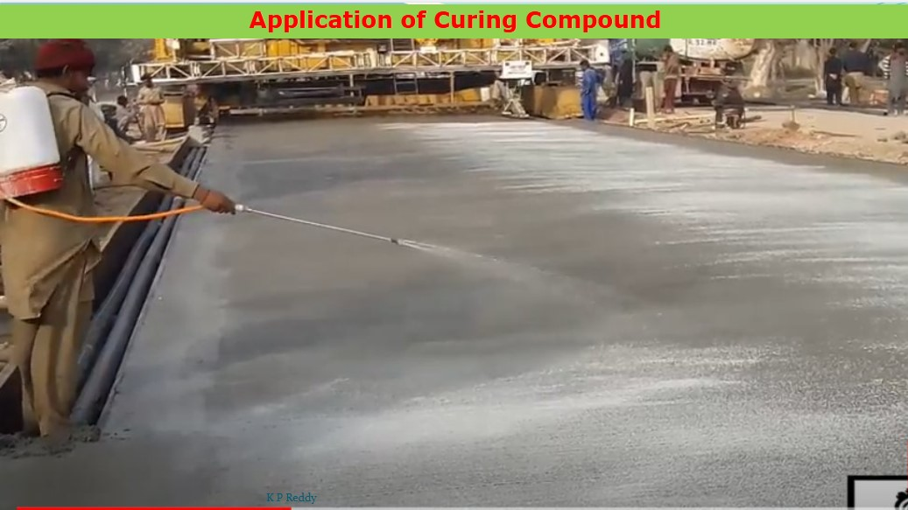
Intermediate Curing
Why is it required – Texturing and joint cutting are to be done before final curing (ponding/saturated burlap …) During this period, to prevent loss of moisture curing compounds may be applied to form liquid forming membrane
Next

Slide 75
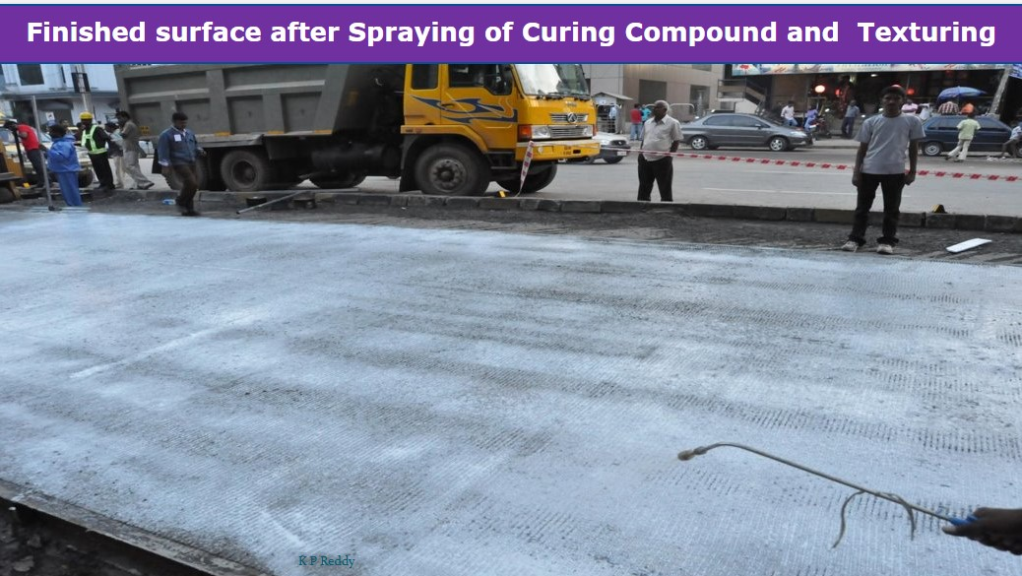
Texturing after Intermediate Curing
Next

Slide 76
Final Curing
Final Curing has to be done after completion of Texturing and Initial Cut of Jointing
Next

Slide 77
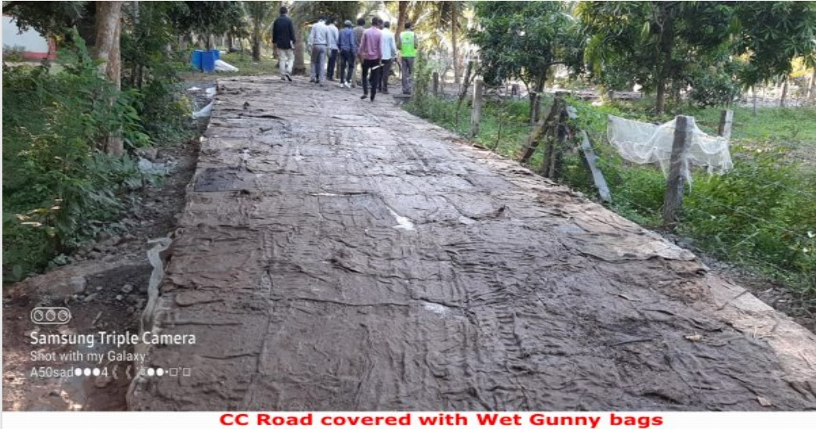
Final Curing – Gunny Bags
Next

Slide 78
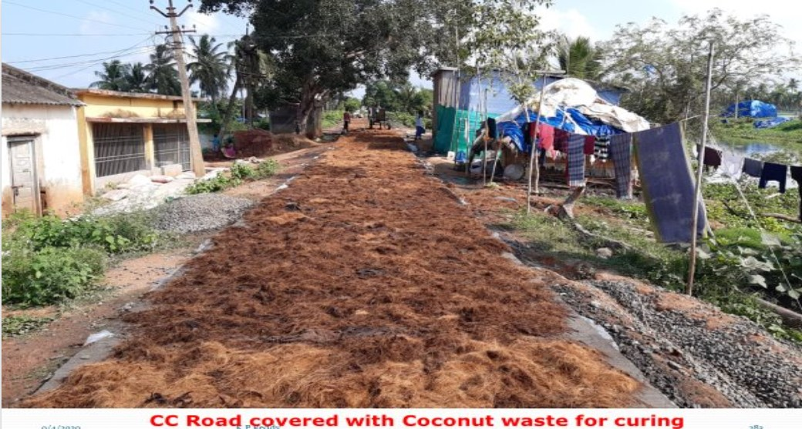
Final Curing – Coconut Waste
Next

Slide 79
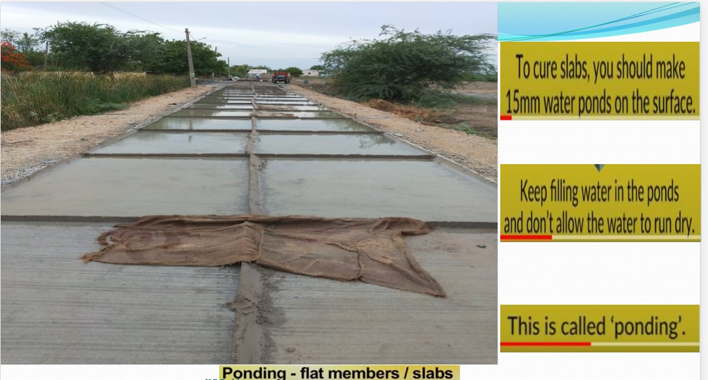
Final Curing – Ponding
Next

Slide 80
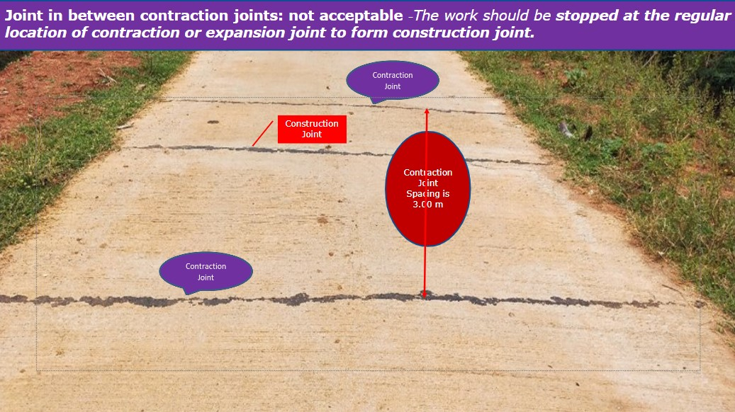
Mismatch – Construction & Contraction Joint
Next

Slide 81
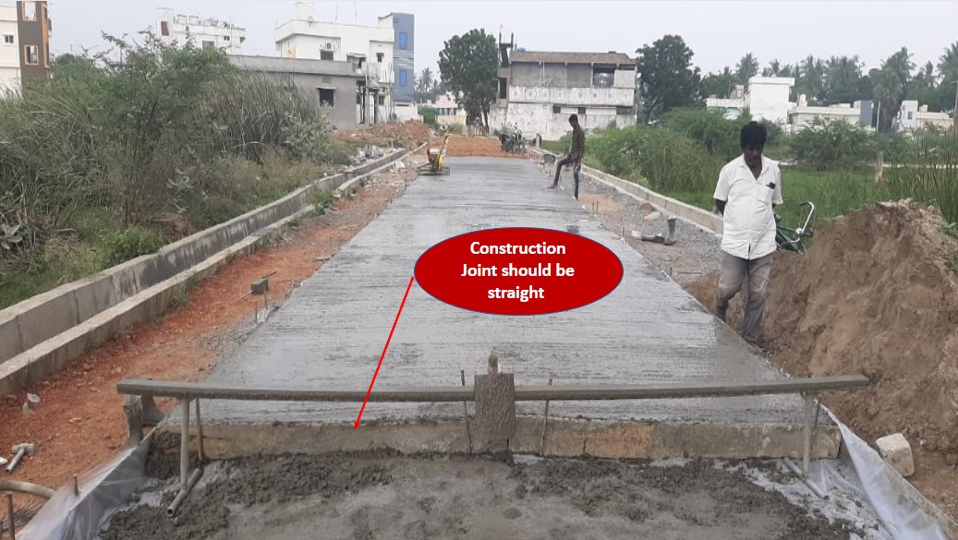
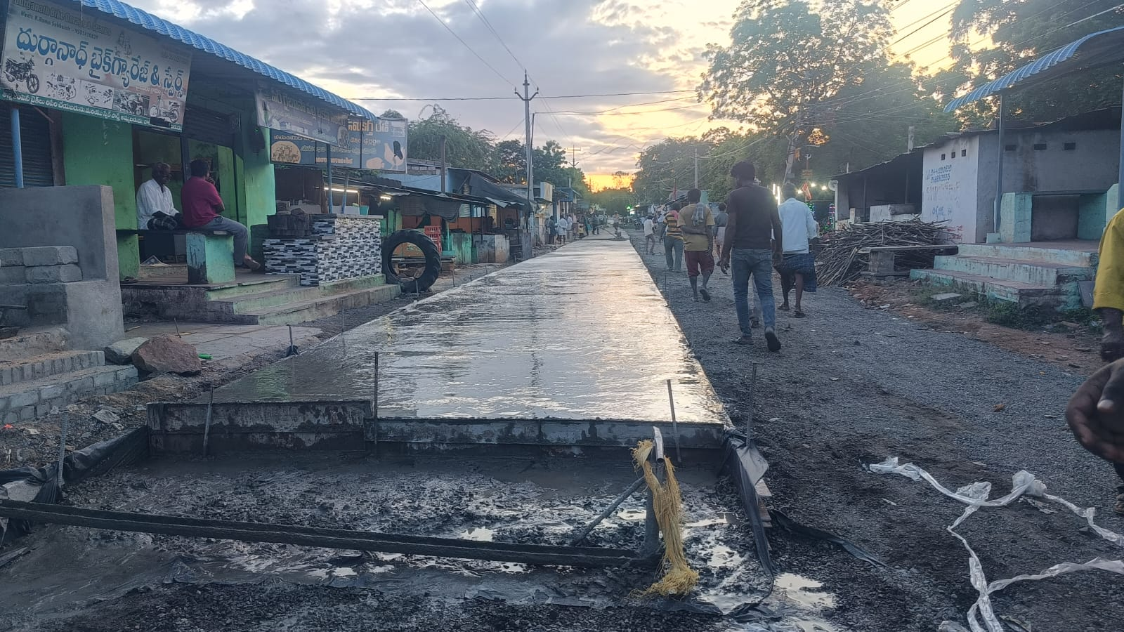
Vertical Construction Joint
Next

Slide 82

Expansion Joint
Next

Slide 83

Expansion Joint @ Deck-slab
Next

Slide 84

Cleaning Groove & Debonding Strip
Next

Slide 85

Insertion of Debonding Strip
Next

Slide 86

Taping of Joints
Next

Slide 87

Sealant Mix
Next

Slide 88

Sealing of Joints
Next

Slide 89

View of Filled-In Joint
Next

Slide 90

Bitumen Filled Joint
Next

Slide 91

Slump
Next

Slide 92

Slump Cone Test
Next

Slide 93

Slump Measurement
Next

Slide 94

True Slump
Next

Slide 95

Shear Slump
Next

Slide 96

Collapsible Slump
Next

Slide 97

Slump Cone Test During Construction of CC Road
Next

